Slide 1
Sanitary Engineering
Water supply Engineering
By
Dr. Muhanad M. Abbas

Slide 2
TODAY TOPICS
Treatment Of Water Supply
Slow sand filter.
Rapid rate filter.

Slide 3
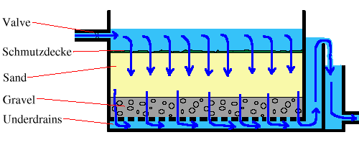

Slide 4
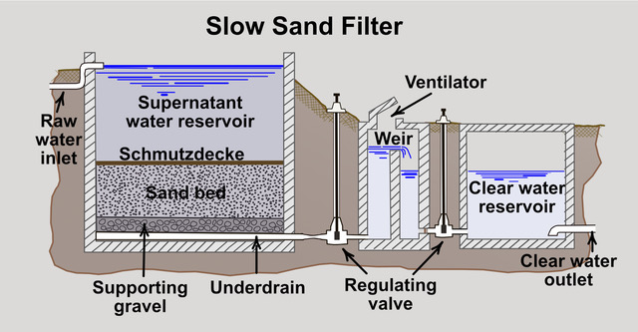

Slide 5
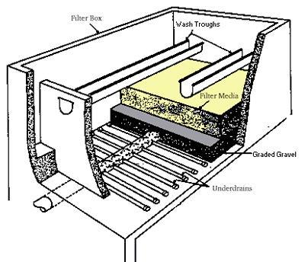

Slide 7
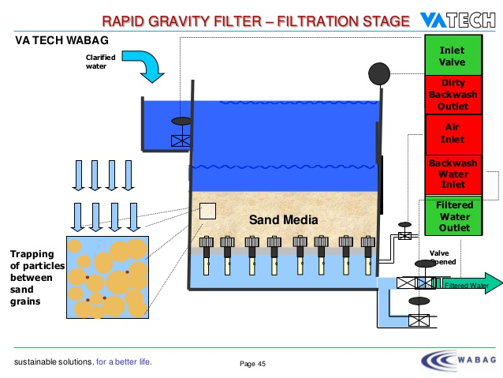

Slide 8
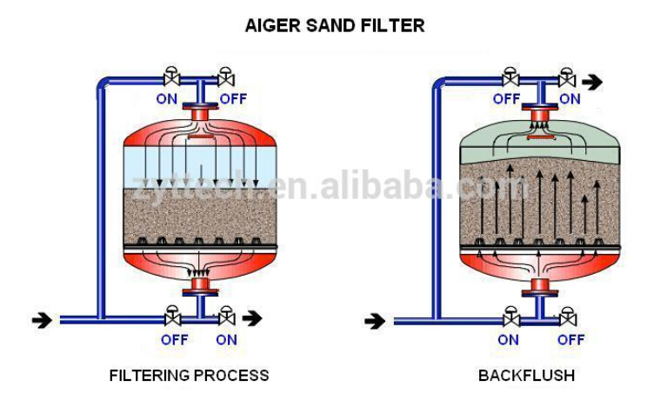

Slide 9
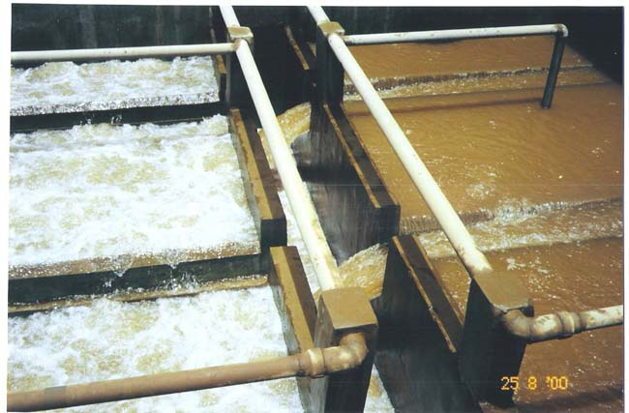

Slide 10
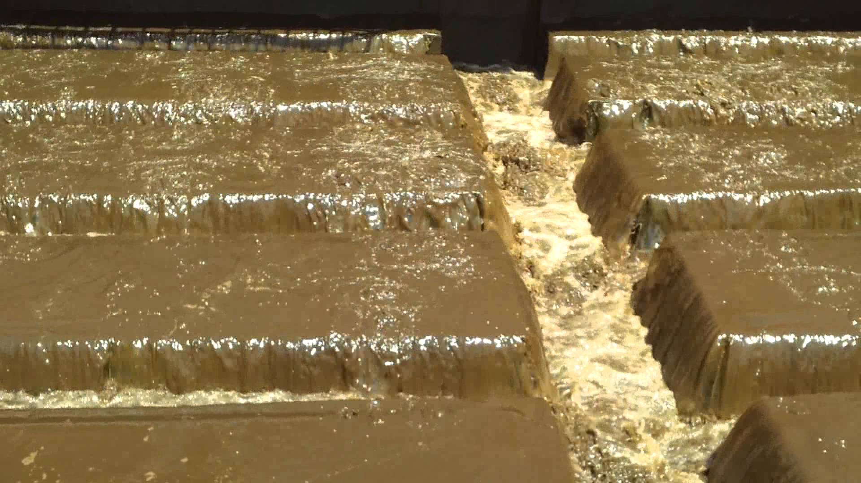

Slide 11
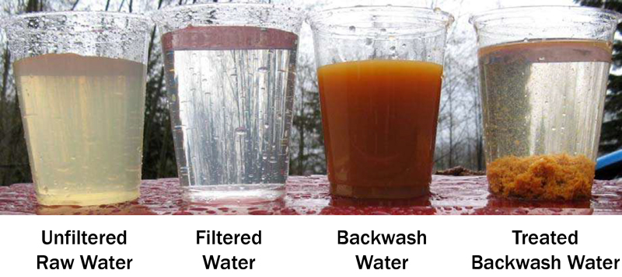

Slide 12
Example: a rectangular trough is to receive wash water from a section of filter bed 2m wide and 3m long the wash water rate is 0.6 m/min, assume y=b .
Solution :-
Q=0.6×3×2=3.6m³/sec
=0.06m³/sec
y=[(0.06)²/9.81 b²] ^{1/3} *1.73
A=0.084m²+50 F.B
use y=b =0.3 m
V=Q/A=0.06 /0.17*0.3
if critical velocity ,critical depth y/1.73 =0.17
V=1.18

Slide 13
Washing process:-
1-turbidity break through exceed design limit (>5 NTV )
2-head through bed reach (2-3)m (7-10)ft.
V _{b} =V _{t}*f^{4.5}
V _{b}= back wash water velocity
V _{t}=terminal velocity , f= porosity of medium
V _{t}=10 D₆₀, D₆₀ = U .C *E.S
D₆₀= product of the effective size and uniformity coefficient in (mm)
The amount of water for washing from (1-5) % of that product. Continue for (5min). Back wash rate >0.3 m/min see example page 253
Air wash system:-
Use air from (0.3-1.5) m/min (7gallon /min /ft²) for few minutes followed by water (0.3-0.5)m/min (7-12gall/min /day ) for (10-15min)

